Slide 1
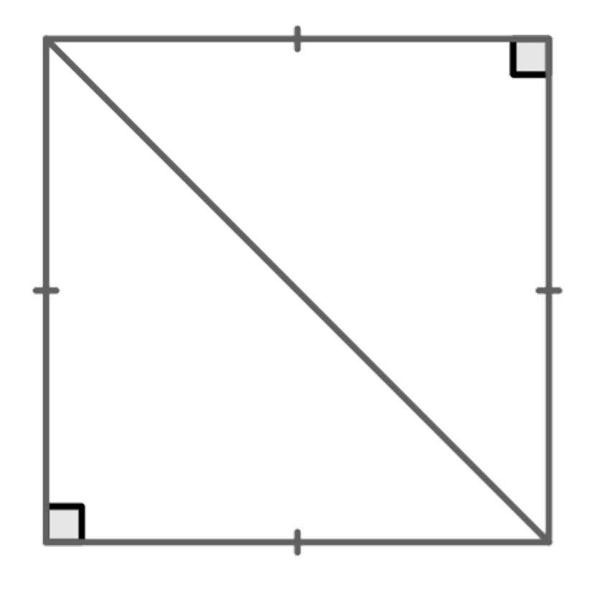
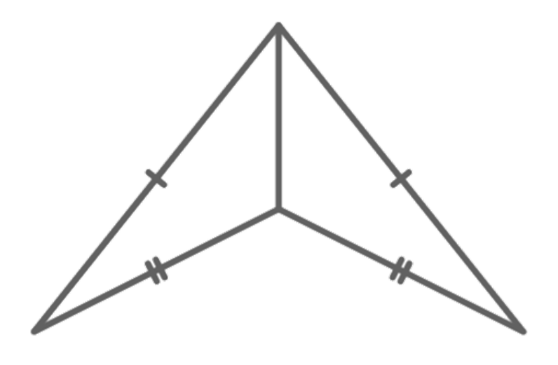
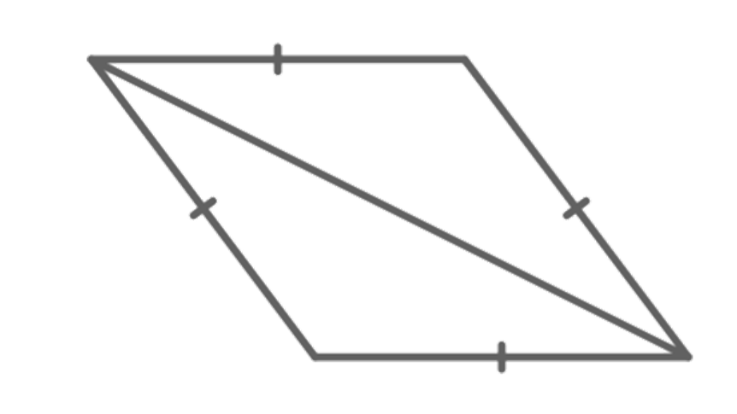
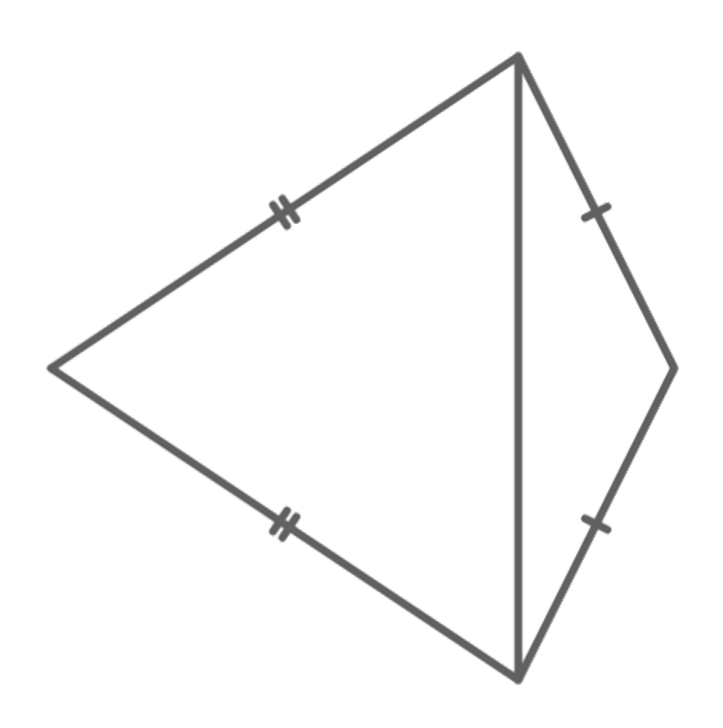

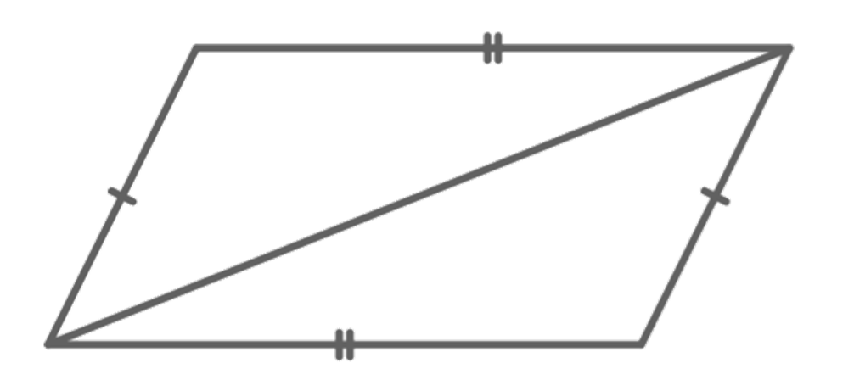
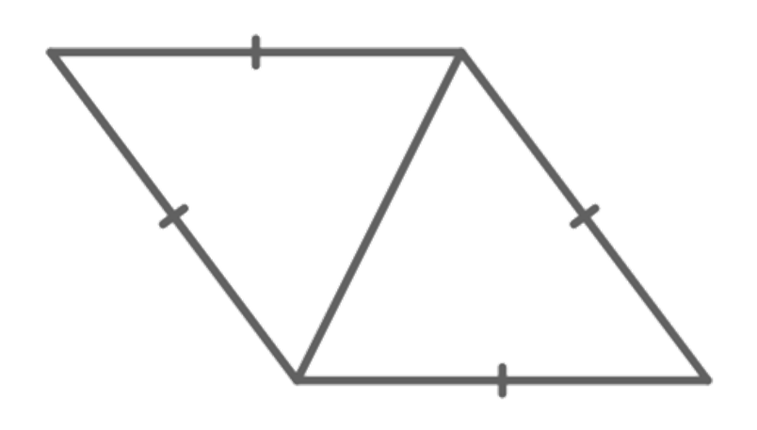
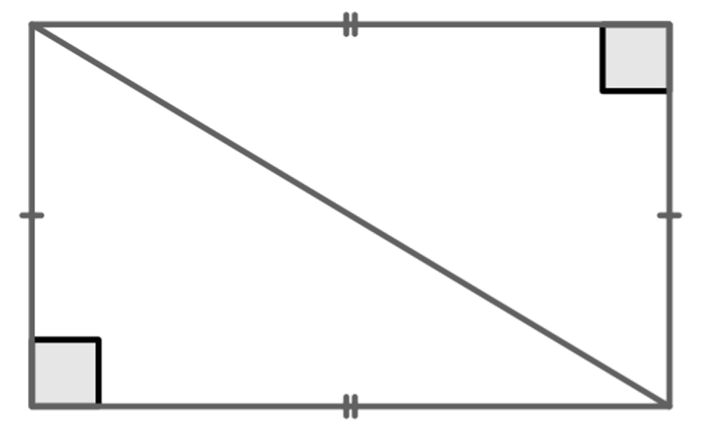
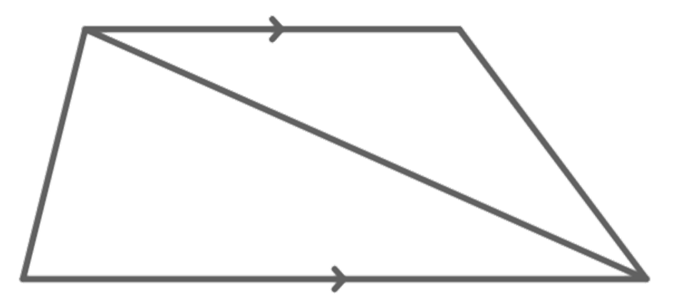

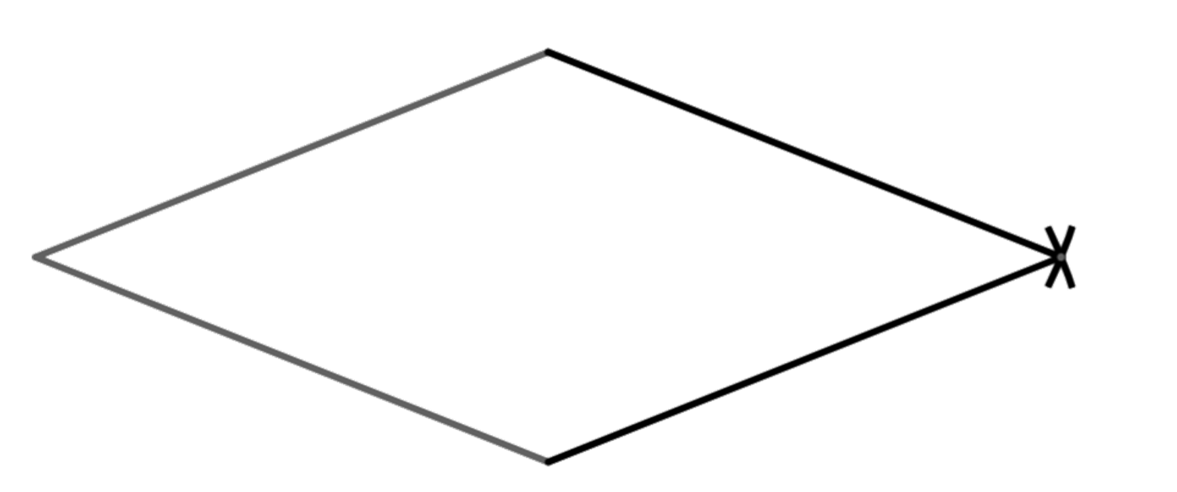
Constructing rhombi
Task A: Creating shapes from triangles
1) By considering the properties of the quadrilateral, what types of triangles are they?
a
b
c
d
2 congruent right-angled isosceles triangles
2 congruent scalene triangles
2 congruent isosceles triangles
2 isosceles triangles
e
f
g
h
2 congruent scalene triangles
2 scalene triangles
2 congruent isosceles triangles
2 congruent right-angled scalene triangles
Task B: Constructing rhombi
1) Finish constructing this rhombus, from the two given sides.

Slide 2
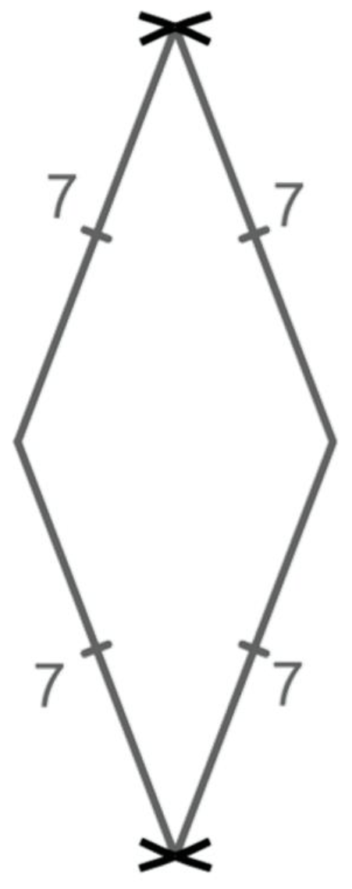
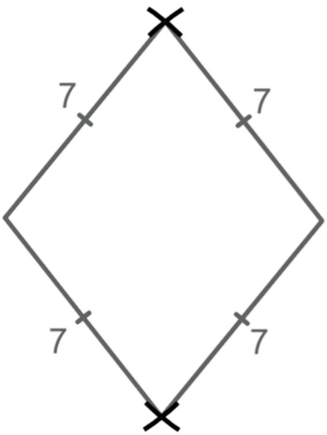
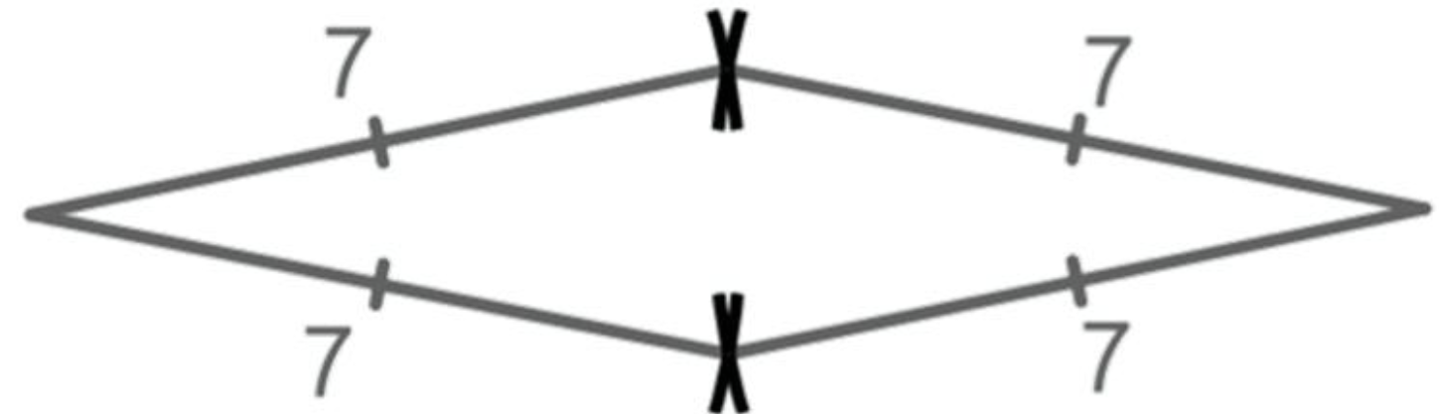
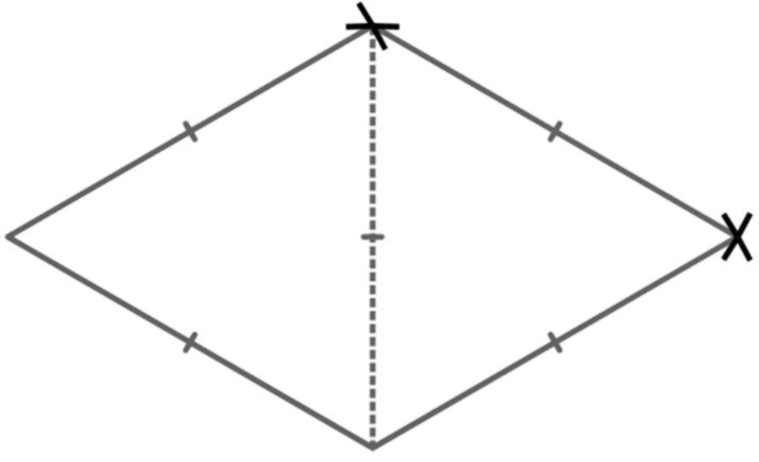
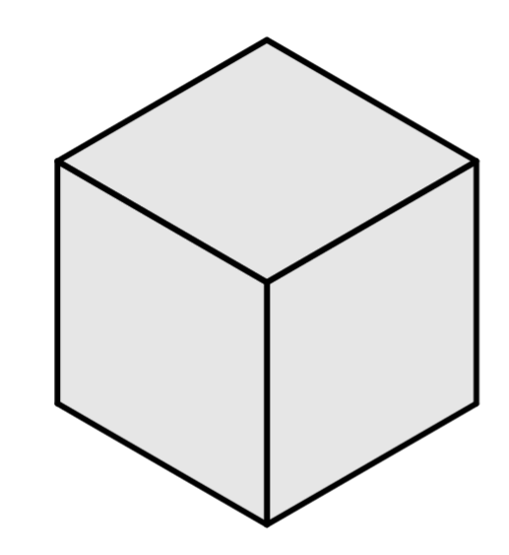
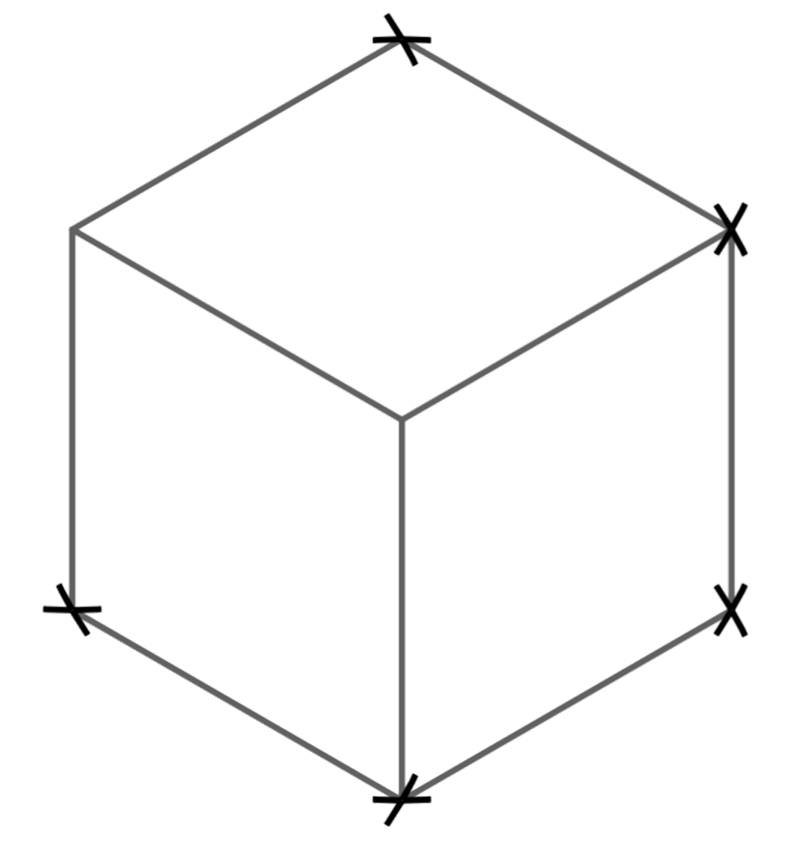
Constructing rhombi
2) Construct three different rhombi, with side lengths 7 cm.
You will need to use a blank sheet of A4 paper for this task.
The base of the isosceles triangles can vary but the two edges that are equal needed to be 7 cm.
3) Construct a rhombus, with a 60° angle.
Two equilateral triangles need to be used. The angles should all be 60°
4) Construct this isometric cube, where each face is a rhombus.
Hint: The three rhombi are congruent, therefore the angles at the centre point (A) are all equal.
60°
A
120°
120°
120°
Mathematics in Education and Industry.
v2.3

